Slide 1

Agile udvikling – Spring 2023 Lecture 01
Andrea Valente
aval@sdu.dk

Slide 2
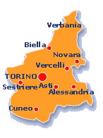
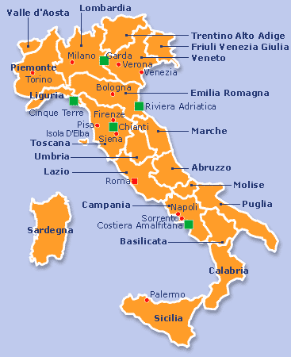

Who am I (?)
Andrea(s) Valente
https://orcid.org/0000-0002-6295-9511
Computer Science Master: computer graphics specialization, but thesis on type systems for object-based languages
Ph.D. on formal languages, theory and implementation of calculi for mobility
Post-doc, research and teaching: AAUE, then SDU Odense

Slide 3
Interests
Computational Thinking/learning
Programming
Graphics/Games
Formal systems
In the past 20 years I have taught courses in:
programming, HCI, math/calculus, image processing, web dev, database, OOP and software design, …
Research interests/projects …

Slide 4
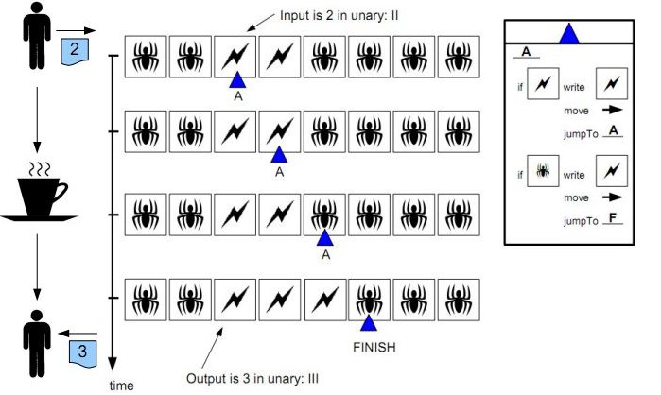
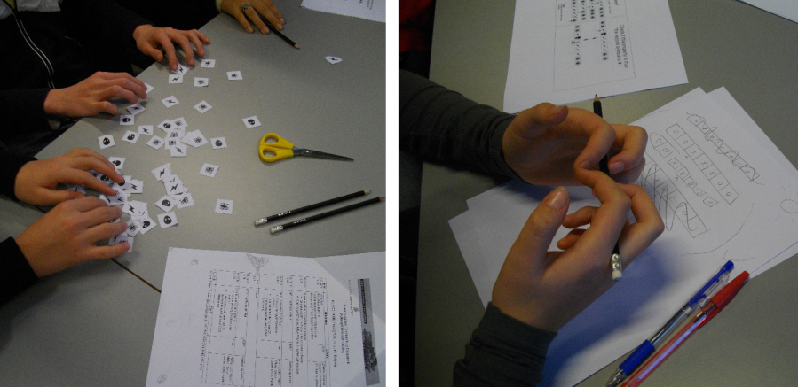
Paper Turing Machine CS as a game -> sense making

Slide 5
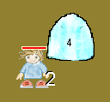
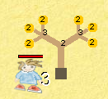
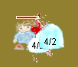
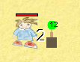
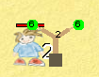
Prime Slaughter Computer game for playful math-learning
Transpose abstract mathematical concepts into playful visual interaction
Prime factorization
Numbers as monsters, swords and trees
A simplified version (browser-friendly) can be found here: http://www.andval.net/tbpsSimple/index.html

Slide 6
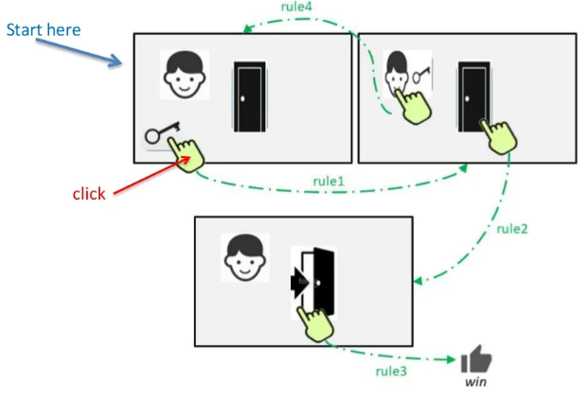
Stick and Click
Presentation: https://www.slideshare.net/andrea270872/stick-click-the-road-towards-friendly-classroomcentered-interactive-digital-content-authoring
The tool: http://www.andval.net/stick_n_click/stick&click.html

Slide 7
Who are you?
(round of introductions)
name - which line - expectations about course
Notes:
Navn
Hvad hedder du?
Studieretning
Hvilket studie kommer du fra?
Studieretning?
Hvad forventer du, af dette fag?

Slide 8
Previous knowledge
Web Dev -> Client-side:
HTML
CSS
JavaScript (?) , JSON (?) , jQuery (?),
P5(?), Phaser(?)
Web Dev -> Server-side:
PHP
MySQL
WebAPIs (?) , serverless DBs? No-sql?
General programming: C#? Python?
Software engineering / development?

Slide 9
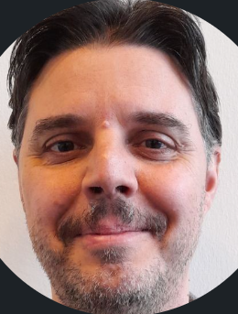
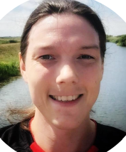
This course
Shared between me and Kasper
I will cover the Agile and XP parts

Slide 10
Kasper will know… :>
Do you know about the exam format?
This course is support for your project(s), right? ;)

Slide 11
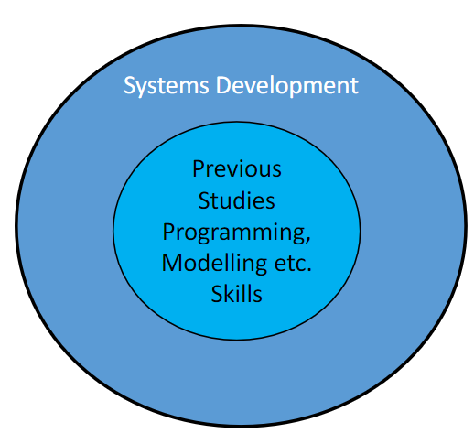
Contents
System development, planning, management
Agile methods
eXtreme Programming

Slide 12
Books
Main book: “Extreme Programming Explained - Embrace Change” Kent Beck and Erich Gamma
Free and online:
Agile Manifesto https://agilemanifesto.org/
M. Fowler: https://www.martinfowler.com/articles/newMethodology.html
More (free) material and webpages when needed…
e.g. (possibly) https://eloquentjavascript.net/
https://learnxinyminutes.com/

Slide 13
Tools
Communication/management tools:
Google docs
Trello https://trello.com/en
Free online resources:
https://www.blindtextgenerator.com/lorem-ipsum
https://dummyimage.com/ (did you know this one?!)
https://www.freepik.com/
Editors (if needed):
Sublime https://www.sublimetext.com/
Brackets https://brackets.io/
Atom https://atom.io/
https://trello.com/andreavalente22/boards And this one in particular: https://trello.com/b/ZswElyCA/test123

Slide 14
(possible) lectures content
See: Studyplan Agile Development.docx

Slide 15

Questions?

Slide 16
Software Systems
We are living in an increasingly digital world -> software systems everywhere
Current high demand for
Software Systems
And Development Skills for managing the building of (and maintaining of) software systems
In particular in the following areas
Websites
Infrastructure -> integration of different systems
Gaming industry

Slide 17
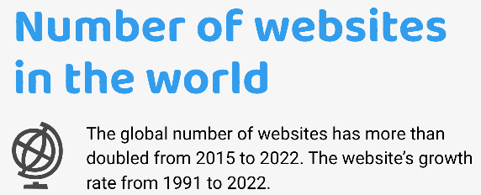
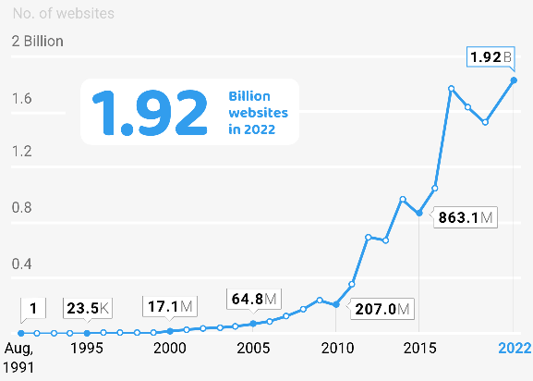
Website Design and Maintenance
More services moving online -> more websites
https://firstsiteguide.com/how-many-websites/

Slide 18
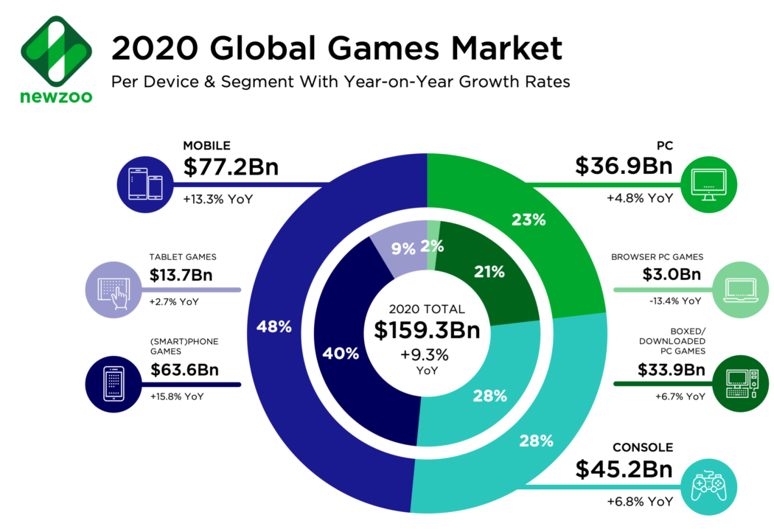
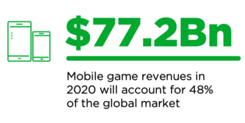
Gaming Industry
Rapid growth!
shttps://newzoo.com/insights/articles/newzoo-games-market-numbers-revenues-and-audience-2020-2023
Notes:
YoY means Year-over-year

Slide 19
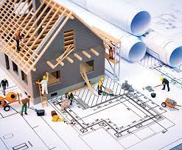
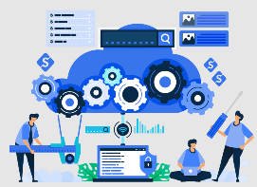
Software Systems Development and Project Planning
House building Vs software building
What to do you think? When/how would you
plan, estimate costs, hire team members, buy materials, design/re-design, maintain, …
your own experience in past semesters… (what prj?)
Vs
5 min

Slide 20
Another example: Bridges Vs Software
According to https://blog.codinghorror.com/bridges-software-engineering-and-god/
“Software development is only like bridge building if you're building a bridge on the planet Jupiter, out of newly invented materials, using construction equipment that didn't exist 5 years ago”

Slide 21
Why is that?
Bridge Building
Although complex, fairly repeatable task
Exhaustively planned and specked out before starting
Clear narrow scope
Tools and techniques change but slowly
Unlikely to be updated (likely just replaced with new bridge)
Scope defines all functionalities and artifacts to be delivered as a part of the product

Slide 22
Software instead…
Although complex, fairly repeatable task
Invariably something brand new (otherwise could buy off the shelf)
Exhaustively planned and specked out before starting
Much harder to define and plan something brand new
Clear narrow scope
Customers less clear on what they want, whey need
Tools and techniques change but slowly
New technologies and programming languages all the time
Unlikely to be updated (likely just replaced with new bridge)
Likely to require maintenance and updates from day 1 of being finished

Slide 23
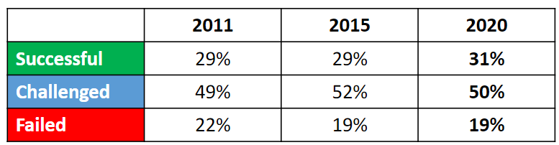
Many software dev projects fail
CHAOS stands for the Comprehensive Human Appraisal for Originating Software
“Snapshot of the state of the software development industry” -> Every few years the Standish Group publish a new CHAOS Report
Latest figures from report 2020:
https://hennyportman.wordpress.com/2021/01/06/review-standish-group-chaos-2020-beyond-infinity/

Slide 24

“Classic” example
IT Failures -EFI SKAT Recovery System
Tax recovery system –to streamline and centralize tax debt recovery
Previously controlled separately by Municipalities
who said “new system would never work”
At the planned delivery date the system was not ready for use
Further delays followed and the initial budget tripled!
Finally went live -> 6 years late
However, system quality issues when data was entered
Writing incorrect dates
Unable to summarize balances
Could not figure out what a citizen or a company owed

Slide 25
(…)
The project did not match the requirements
Was not clear what the system was going to do
Misjudged the complexity of, for example, certain types of debt
System was suspended and then shutdown
The State expects to lose many billions of DDK
Read more: https://www.dr.dk/nyheder/penge/skandalen-om-skats-it-system-efter-11-aars-fiasko-koster-det-millioner-lukke-efi-ned

Slide 26
Task
Explore for yourself a “systems development failure” and…
Investigate the failure and the consequences
Explore the reason(s) behind its failure
Are there re-occurring variables that impact a Software Systems’ Development?
Ideas:
Cyberpunk 2077 failure -> google it ;)
Electronic Land Registry in Denmark. See Why_the_Electronic_Land_Registry_Failed PDF
The Therac-25 machine. See https://hackaday.com/2015/10/26/killed-by-a-machine-the-therac-25/
10/15 min

Slide 27
What did you find out?
failure and consequences?
reason(s) behind failure?
variables/factors?

Slide 28
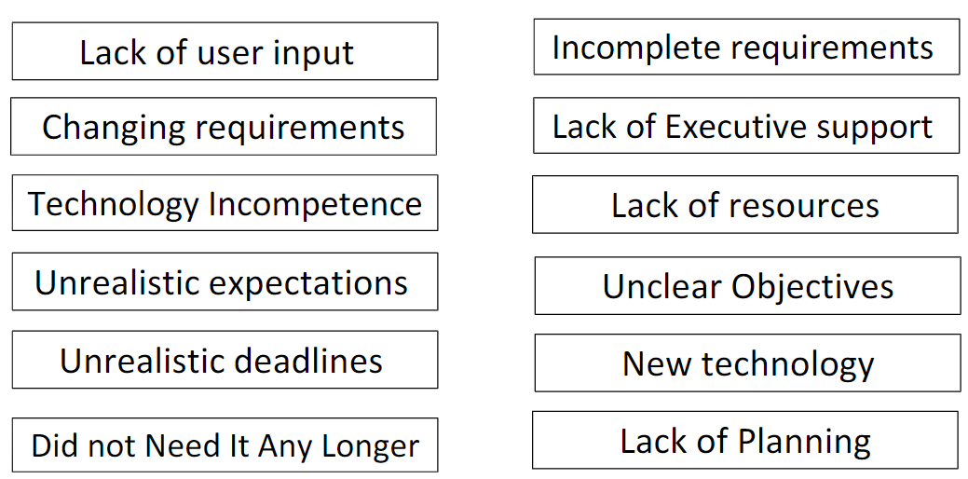
Factors in failure
From paper: “Project Management Practices: The Criteria for Success or Failure”

Slide 29
On the other hand…
“Chaos report” factors of success
Identification and ranking of the factors which work together to make projects more successful
Executive Support
Emotional maturity
User Involvement
Optimization (e.g. managing scope based on relative business value)
Skilled staff (people who understand both business and tech)
SAME (Standard Architectural Management Environment)
Agile proficiency
Modest execution (having a process with few moving parts)
Project management expertise
Clear Business Objectives

Slide 30
Software System Development
Goal: realizing a project on time, on budget with a satisfactory result
To do so we need to:
Work out what customer wants
Design build and test
Release the product

Slide 31
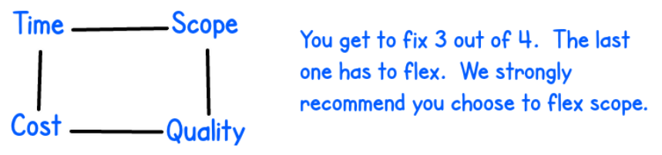
Software System Development: 4 variables
What we are hoping to achieve (features/scope and quality)
By when (time) for this much resource (cost)
Try this: the customer wants high quality, product delivered in short time, and all features implemented… then you have to ask for a lot of money ;)
Try other combinations…
Controlling the scope is the best option for a development team
From https://jchyip.medium.com/four-variables-cost-time-quality-scope-f29b4de8bfdf
Notes:
Scope == features
High quality == a codebase that has no/few errors, it is easy to read, easy to modify and maintain

Slide 32
Back to the bridges…
Bridges Vs Software
Delivering successful Software Development Projects difficult
Hard to determine from the user/customer want they want
Hard to capture and define what a customer wants
Many of the details emerge during the implementation phase -> malleability
IT projects may change due to stakeholders or external reasons
Many possibilities of tech to use and what designs should look like
Human error

Slide 33
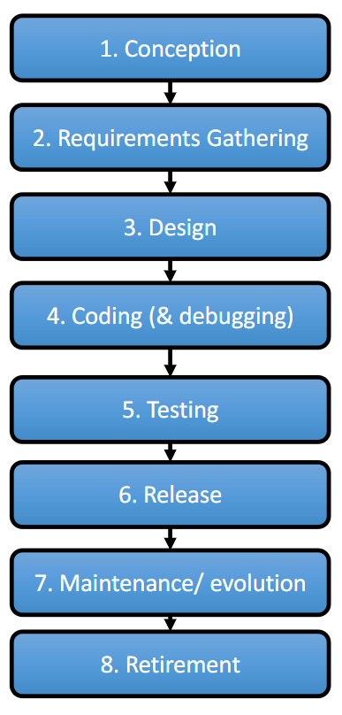
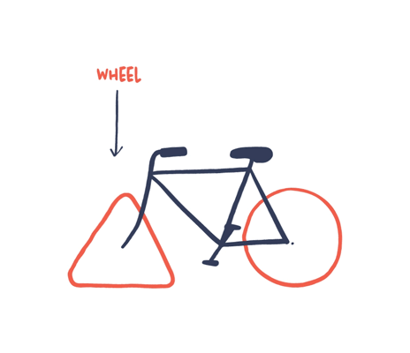
System Development Life Cycle
Typical phases of SDLC ---->
But how can we actually proceed?
Should we reinvent the wheel?
How was it done in the past?

Slide 34
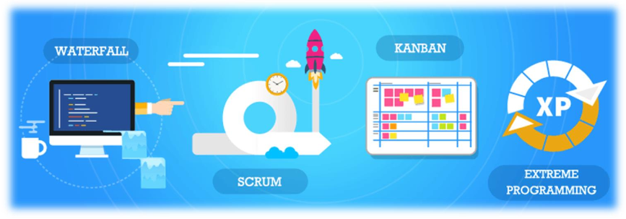
System Development Models
DEF: provide a rational design process/method/model for the development of systems/software
Many different development models were developed
In reality different development models may be most appropriate in different circumstances
Or mix&match (AKA customization)

Slide 35
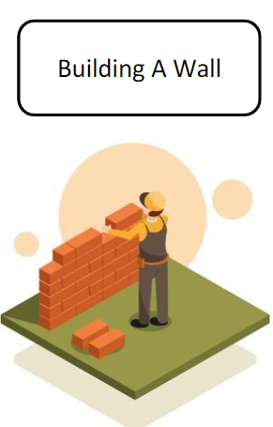
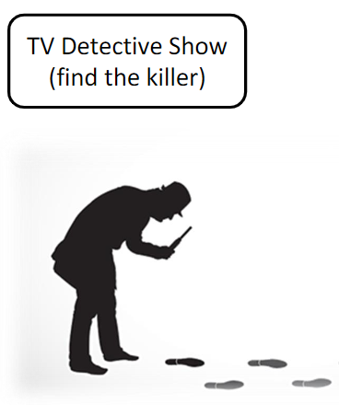
Predictive and Adaptive
2 different categories of methods
Predictive development models
You predict in advance what needs to be done
Then go and do it
Sometimes called Linear/Sequential Software development
Adaptive development models
Enables ongoing change to a project’s goals when necessary
Periodically re-evaluate and decide whether change is needed

Slide 36
Examples of methods
Waterfall
Spiral
Unified Process (UP)
Agile (a family of adaptive methods)
eXtreme Programming
Scrum

Slide 37
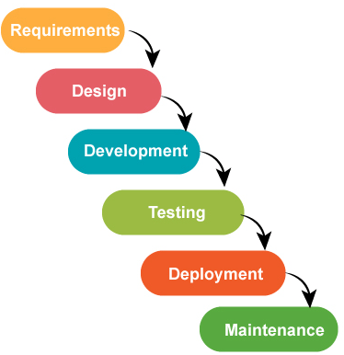
Waterfall
Assumption: finish each step completely before you move on to the next step
Information cascades from one step to the next
(very) predictive
Could work if…
small project
clear goal(s)
experienced team / small team
Risks:
can’t handle change
needs stable+clear requirements
https://martinfowler.com/bliki/WaterfallProcess.html

Slide 38
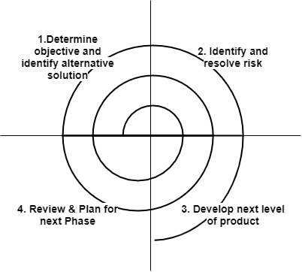
Spiral
Better working incrementally
Recognizes that the released product can be feedback into another iteration
Basically spiral improves over waterfall by “rolling” the process up!
Predictive
Read more here: https://techdifferences.com/difference-between-waterfall-model-and-spiral-model.html

Slide 39
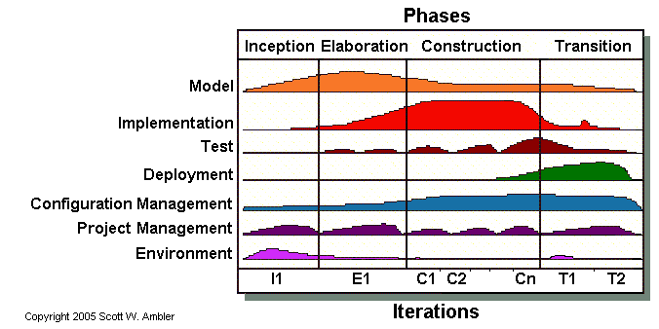
UP
Works in phases, divided into iterations
Predictive (but with some agile features)
Iterative, incremental and risk-focused!
time
https://theteche.com/the-unified-process-in-software-engineering/

Slide 40
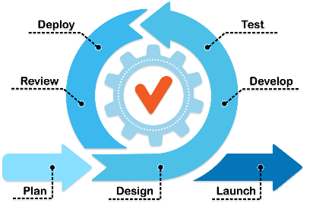
Agile methodologies
See the manifesto https://agilemanifesto.org/
Adaptive, iterative, time-boxed
Implementations:
Scrum, XP, RUP/AUP, Kanban
eXtreme Programming has “values”:
Communication
Simplicity
Feedback
Courage (!) ---> to accept feedback, to ask deep questions, to stop doing X and try Y
Respect

Slide 41
Questions?

Slide 42
Break

Slide 43
OK, but where to start… ?
If you are working on a project, in groups, …
Consider using an inception deck

Slide 44
Inception Deck (3 parts out of 10)
Ask yourselves difficult questions… and write down the answers:
Ask “why we are here?” by showing a clear goal
Create an elevator pitch to concisely describe the project
A good elevator pitch will quickly communicate your idea, establishing clarity, identifying the key customer, and quickly showing the intended benefit you’re aiming to deliver.
Design a product box or logo to advertise exactly what you will get by providing your product/service
To rapidly convey key features and their benefits, and create an emotional connection with your team and stakeholders in what they’ll get from your project.
Possibly: create a quick mood-board to help you in point 3 ;)
From “Agile Samurai” (free summary: https://tdevroome.medium.com/book-summary-the-agile-samurai-52b269bbb7fc )

Slide 45
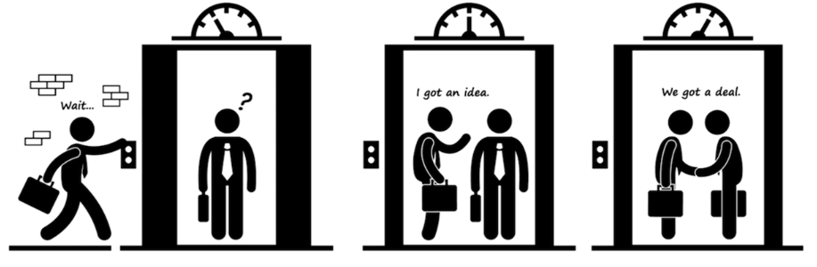
(2) Elevator Pitch
(possible) Template:
For [target customer]
Who [statement of need or opportunity]
The [product name]
Is a [product category]
That [key benefit, compelling reason to buy]
Unlike [primary competitive alternative]
Our product [statement of primary differentiation]

Slide 46
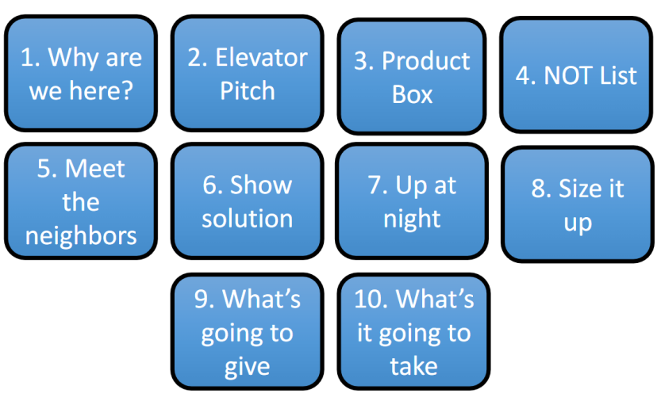
The whole deck…
goal of the group / project
30 seconds, 2 lines, presentation of idea (!)
Or concept art or (a quick) mood board https://risinghighacademy.com/5-reasons-for-creating-mood-boards-in-game-development/
features that will NOT be in this product
not possible unless you have actual users…
overview: diagram, UML, components, GUI mockup
Risks!
Estimation of cost, time, effort
What do you think you/group should prioritize?
A simple group contract
From “Agile Samurai” (free summary: https://tdevroome.medium.com/book-summary-the-agile-samurai-52b269bbb7fc )

Slide 47
Task (now and next week)
Work in groups, 3-5 per group
Project work:
Each group: brainstorm about a possible project/or your current project
Suggestion: https://app.creately.com/ create a free account, then work on a mind map
Use the “inception deck” to write/document about the idea (see next page->)
Consider looking at these, to start the conversation:
SOCIAL WEB SITE -> Suggestions for using ingredients: https://www.supercook.com/
WEB SITE -> Edu resources: https://www.csunplugged.org/en/
Educational programming game: Lightbot https://www.youtube.com/watch?v=5LPy8W_64pE (walkthru)
Microbit projects: https://www.hackster.io/microbit/projects

